Slide 1
Robustness Milestone 5: Trade-offs and Interactions with other verticals in Trustworthy AI
Roseline Polle
Postgraduate, UCL
roseline.polle.19@ucl.ac.uk
Notes:
Assessing and Mitigating Bias and Discrimination in AI
Part I: Ethical, Legal, and Governance aspects of AI Bias and Discrimination
Part II: Technical dimensions of Bias and Discrimination in Supervised Machine Learning

Slide 2

What is Robustness?
Technical Robustness and Safety (EU guidelines):
Resilience to attack and security
Fallback plan and general safety
Accuracy
Reliability and Reproducibility
EU-HLEG. (2019). Ethics guidelines for trustworthy AI. https://digital-strategy.ec.europa.eu/en/library/ethics-guidelines-trustworthy-ai

Slide 3
Resilience to attack and security
Quality of a system to be safe, not vulnerable to tampering.
Protect against hacking: data poisoning, model leakage or the infrastructure, both software and hardware.

Slide 4
Type of ML attacks
Integrity: Misclassifications that do not compromise normal system operation (evasion, poisoning,…)
Availability: Misclassifications that compromise normal system operation (poisoning)
Privacy/Confidentiality: infer information about user data and models.
Biggio, Battista, and Fabio Roli. "Wild patterns: Ten years after the rise of adversarial machine learning."
Notes:
Biggio, Battista, and Fabio Roli. "Wild patterns: Ten years after the rise of adversarial machine learning." Pattern Recognition 84 (2018): 317-331.

Slide 5
Example of ML attacks
Evasion attacks: manipulating input data to evade a trained classifier at test time
Poisoning attacks: injecting a small fraction of poisoning samples into the training data (occur during the training phase) to increase misclassification at test time.

Slide 6
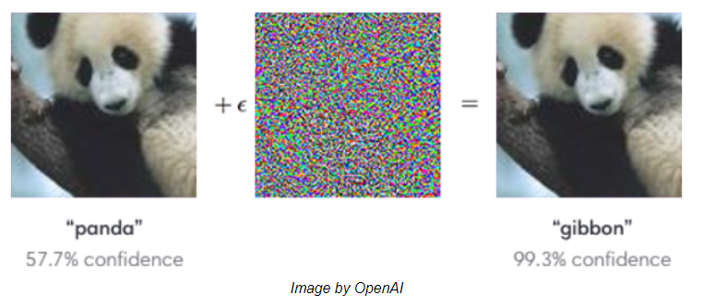
Small changes in input
Small changes in input should lead to small changes in output
[Goodfellow et al., 2015]

Slide 7
Fallback plan and general safety
Safeguards that enable a fallback plan in case of problem
Continue operation with minimisation of unintended consequences and errors: human-in-the-loop, switching to rule-based,…

Slide 8
Accuracy
High level of accuracy desirable
Explicit and well-formed development and evaluation process

Slide 9
Reliability and Reproducibility
Works properly with a range of inputs and in a range of situations
Same behaviour when repeated under the same conditions

Slide 10
Robustness and Fairness

Slide 11
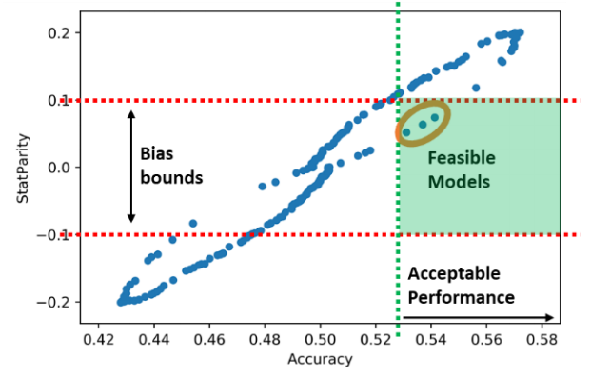
Bias vs Accuracy
Towards Algorithm Auditing by Koshiyama et al., 2021

Slide 12
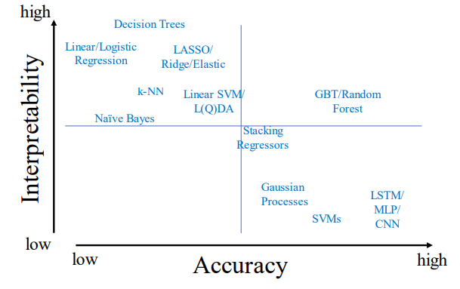
Accuracy vs Explainability
Towards Algorithm Auditing by Koshiyama et al., 2021

Slide 13
Further readings
Why Robustness is not Enough for Safety and Security in Machine Learning by Christian Kästner
Goodfellow et al., Explaining and Harnessing Adversarial Examples

